Slide 1

Turning Effects of Forces
Can we torque about this?

Slide 2
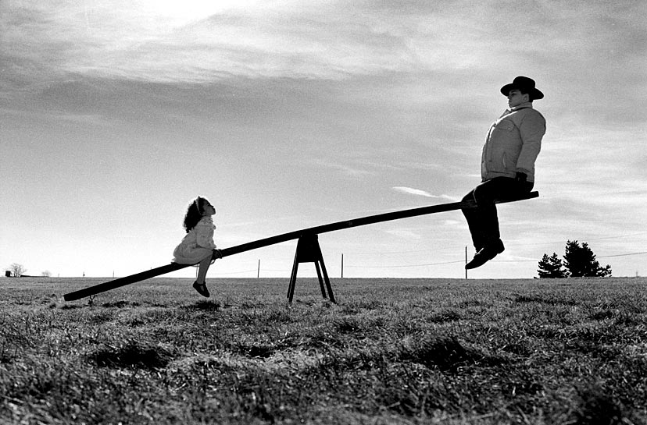
Today’s lesson
Something funny is going on here??
Know what the turning effect of a force is
Know that the moment of a force depends on force and the distance from the pivot
when an object experiences a net force at a distance from a pivot and at an angle to the lever arm, it will experience a torque or moment about that point

Slide 3

What happens when you try to open a door with one finger?
Where do you push?
Hi, my name is Mr Stick
hinges

Slide 4
Do you push near the hinges?
I can’t do it!

Slide 5
Do you push far from the hinges?
That’s easier!

Slide 6
The turning effect of a force depends on two things;
The size of the force
Obviously!

Slide 7
The turning effect of a force depends on two things;
The distance from the pivot (axis of rotation)
Not quite so obvious!
Axis of rotation

Slide 8
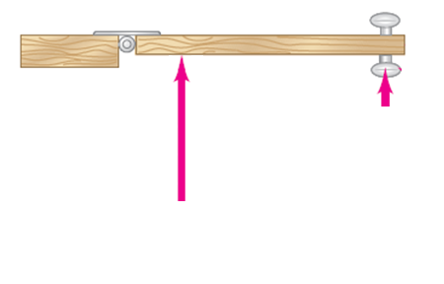
To get the same turning effect closer to the hinge, a larger force is required

Slide 9
Turning effect of a force
The turning effect of a force is called the moment of the force.
It is also commonly known as Torque
The moment is calculated by multiplying the force (perpendicular to the pivot) by the distance from the pivot

Slide 10
Turning effect of a force – moment of a force or TORQUE
Moment (torque) (Nm) = distance from pivot (m) x Force (N)
This assumes that the Radius and the Force are perpendicular to each other.
If they are not then the perpendicular component must be used. (thus the sin θ)
Note the unit is Nm, not N/m!

Slide 11
A simple example!
50 N
0.15 m
nut
spanner (wrench)

Slide 12
A simple example!
Torque = 0.15 x 50 x sin 90
Torque = 7.5 Nm
50 N
0.15 m
nut
spanner (wrench)

Slide 13
What do you do if the nut won’t move and you can’t push harder?!
50 N
0.15 m
nut
spanner (wrench)

Slide 14
Get a longer spanner!
Moment = Force x distance from pivot
Moment = 50 N x 0.25 m
Moment = 12.5 Nm
50 N
0.25 m
nut
spanner (wrench)

Slide 15

Moments – Turning forces
A longer lever arm is very helpful in rotating objects.

Slide 16

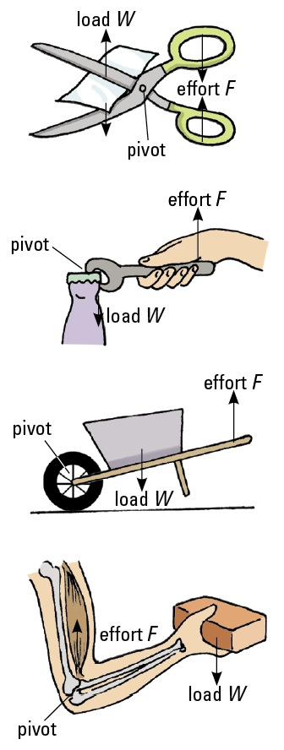
Moments – Turning forces
Sometimes levers can reduce the size of the force required, whilst others increase the distance or speed of movement instead.

Slide 17
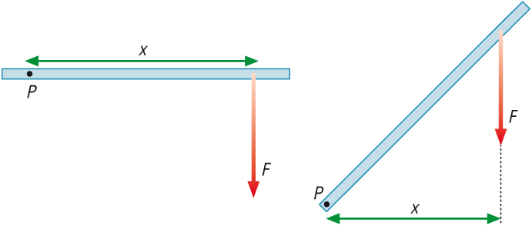
Moments - Effect of Angles
What is the significance of this diagram ?
X shows the perpendicular distance
from the pivot to the line of force.
This is important because torque is the product of the force and the perpendicular distance to the line of its action.
Alternatively the component of the force perpendicular to the radius.

Slide 18
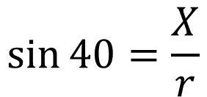


Moments - Effect of Angles
How could the the perpendicular distance from the pivot to the line of force be calculated?
θ = 40⁰
Radius = r

Slide 19
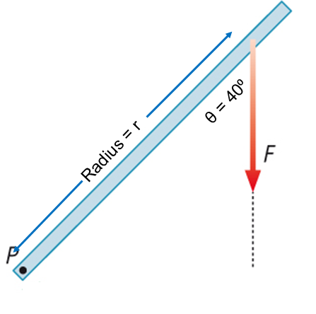
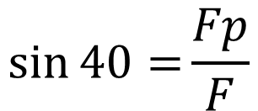


Moments - Effect of Angles
Alternatively we could find the component of the force that is perpendicular to the radius.
F_{p}
40⁰

Slide 20


Moments - Effect of Angles
Two methods Same Solution.
F_{p}
θ = 40⁰
Radius = r
40⁰

Slide 21
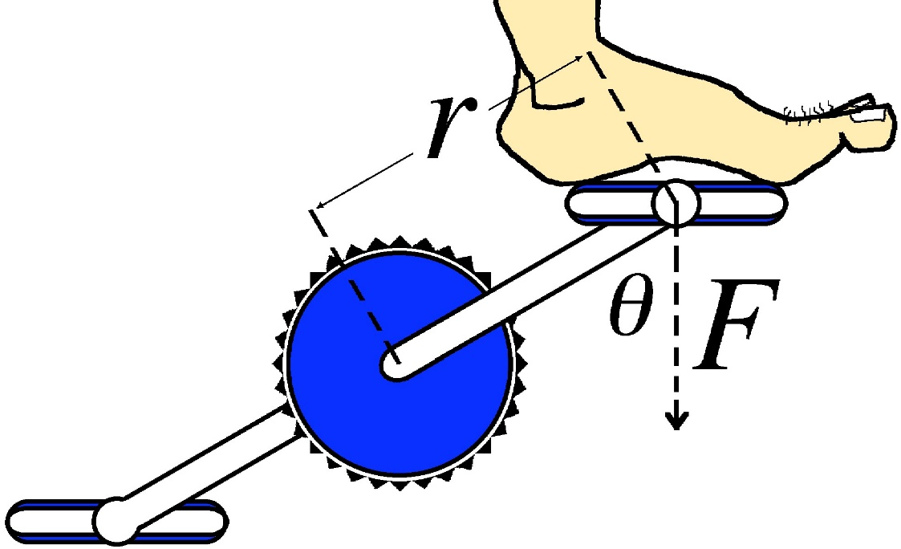
Moments - Effect of Angles
Example: The length of a bicycle pedal arm is 0.152 m, and a downward force of 111 N is applied by the foot.
What is the magnitude of torque about the pivot point when the angle θ between the arm & vertical is: 30.0° (as shown) 90.0° (i.e. pedal at right angles) and 180° (i.e. straight down)
30.0° t = 0.152 x 111 x sin 30.0° = 8.44 Nm
90.0° t = 0.152 x 111 x sin 90.0° = 16.9 Nm
180.0° t = 0.152 x 111 x sin 180.0° = 0 Nm

Slide 22
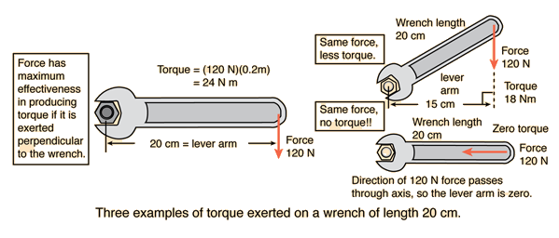
What method you use depends on the information provided in the question.

Slide 23

Moments – Chapter 3.1
No dogs were harmed in today’s presentation, but just to be on the safe side ..
You better get working NOW!!

